Slide 1
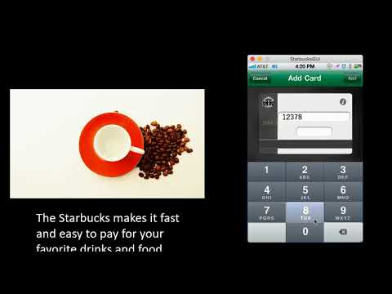

Slide 2
By:
Team: Mystic
Yinghua Qin
Thol Chidambaram
Mitesh Kumar
Srivatsa Mulpuri
Vidhi Sharma

Slide 3
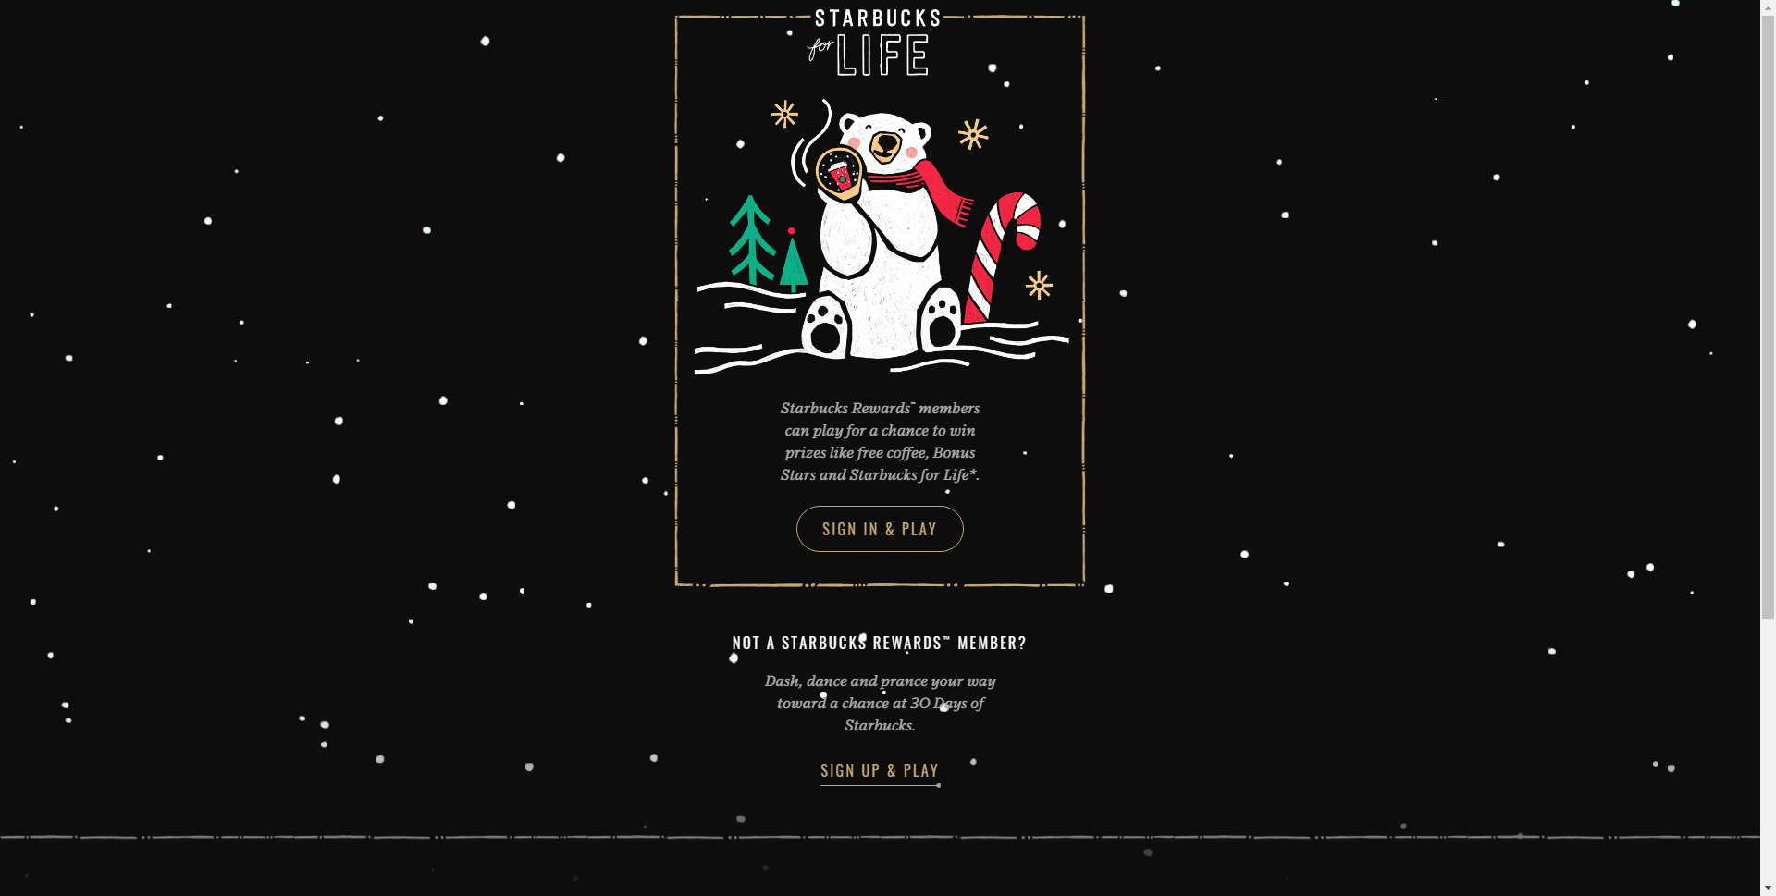
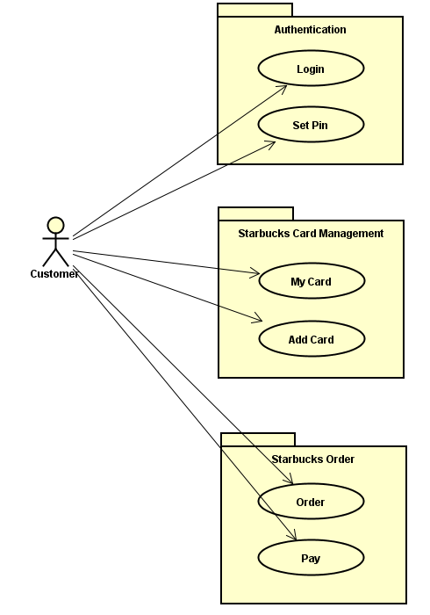
Visitor / Strategy (system)
Command (set pin)
Decorator
(set pin)
State
(set pin)
Decorator
(pin screen)
Builder (Order)

Slide 4
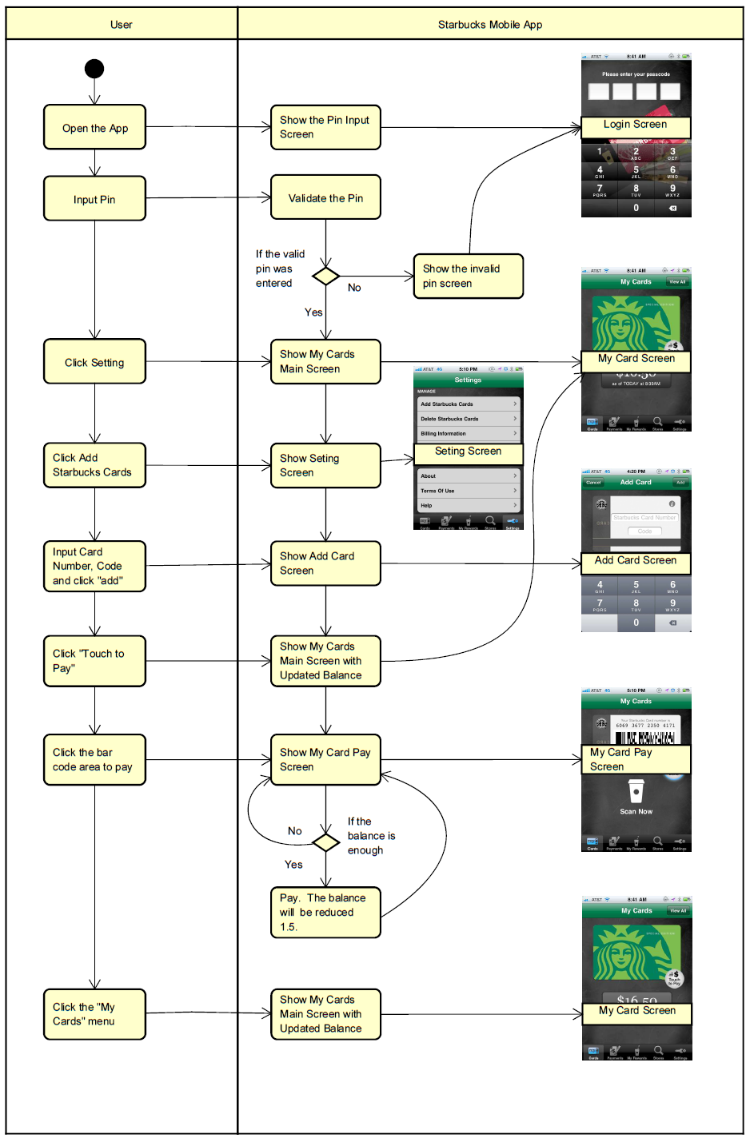
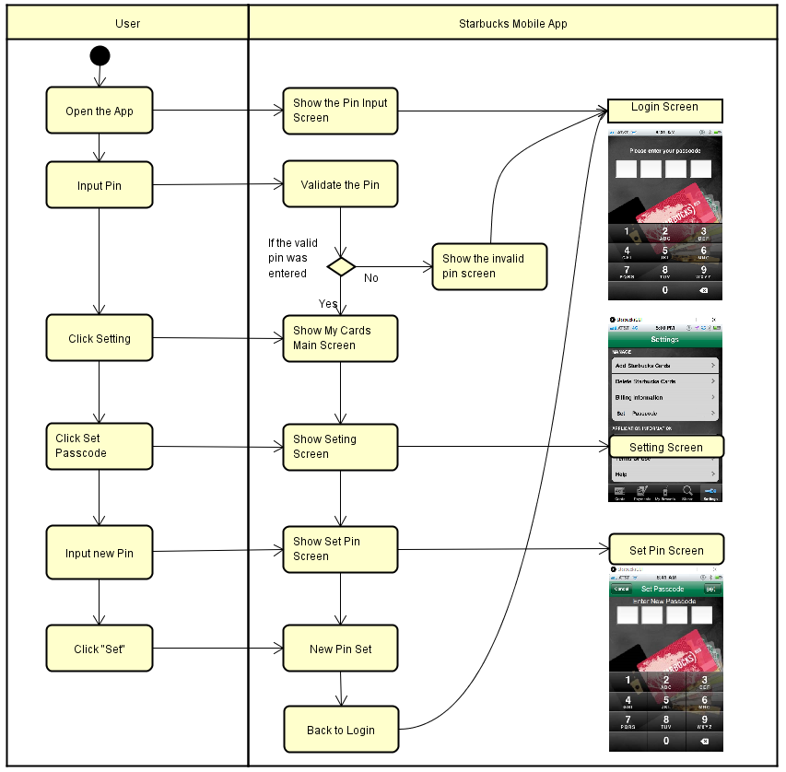

Slide 5
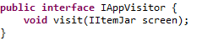
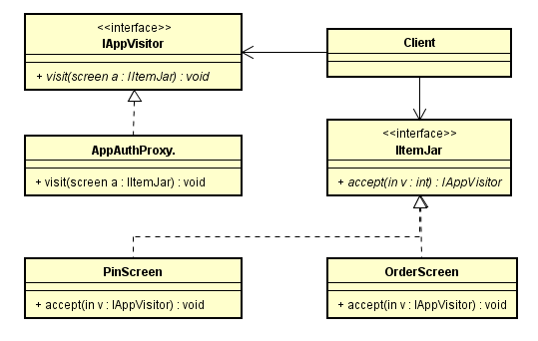
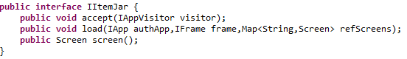
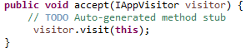
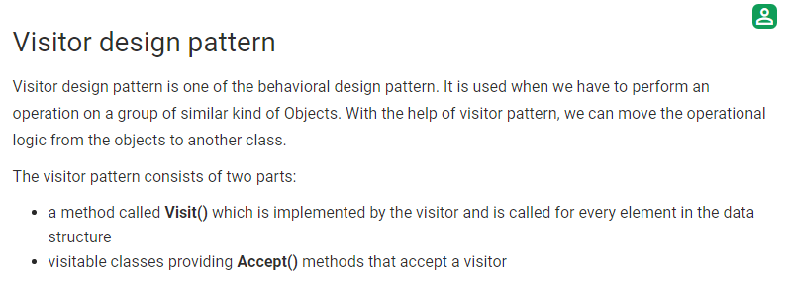
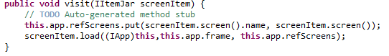
Visitor
(Source: https://www.geeksforgeeks.org/visitor-design-pattern/)

Slide 6
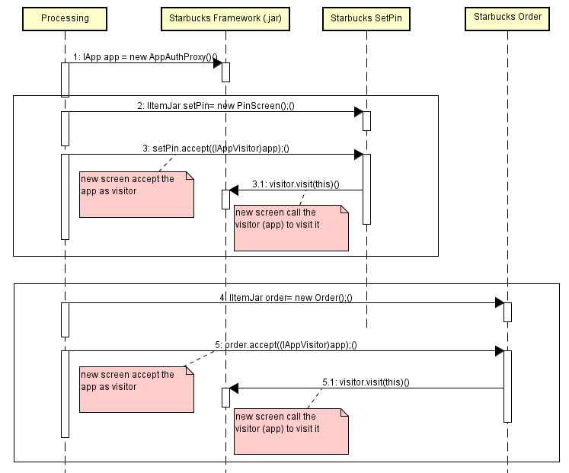
Visitor

Slide 7
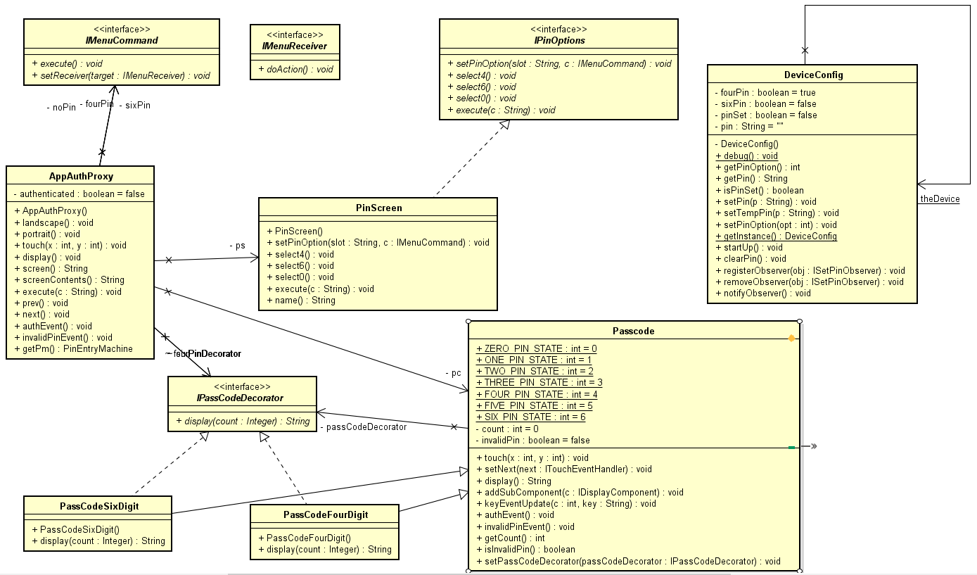
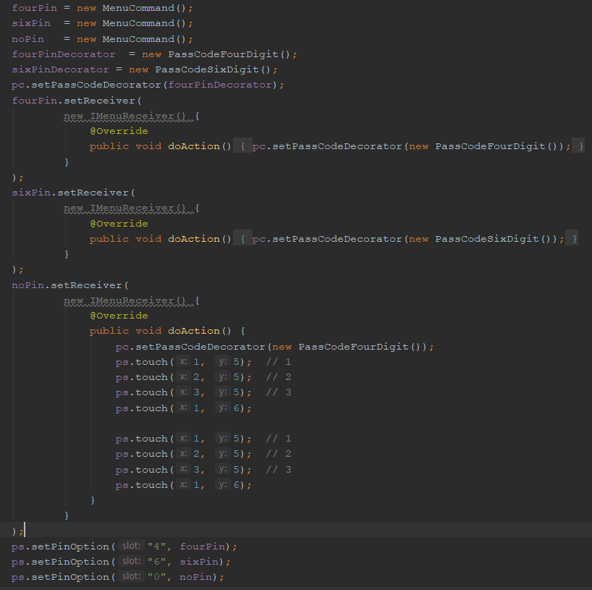
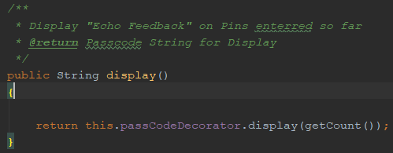
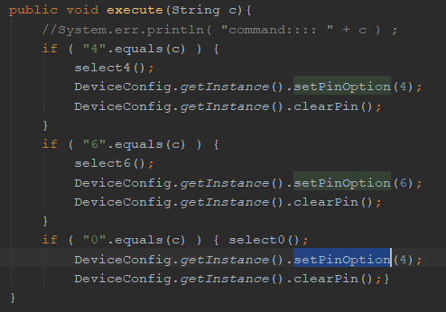
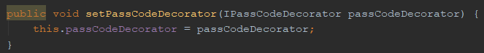
Command

Slide 8
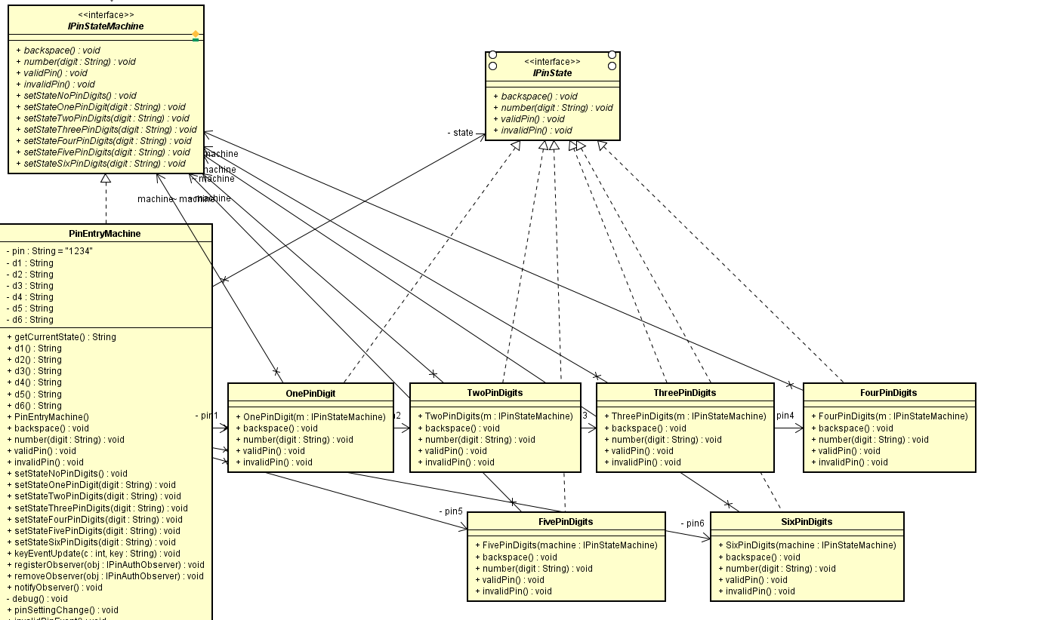
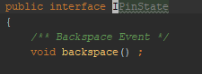
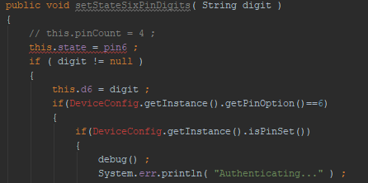
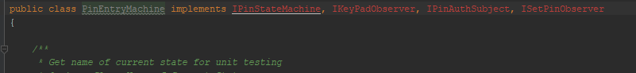
State

Slide 9
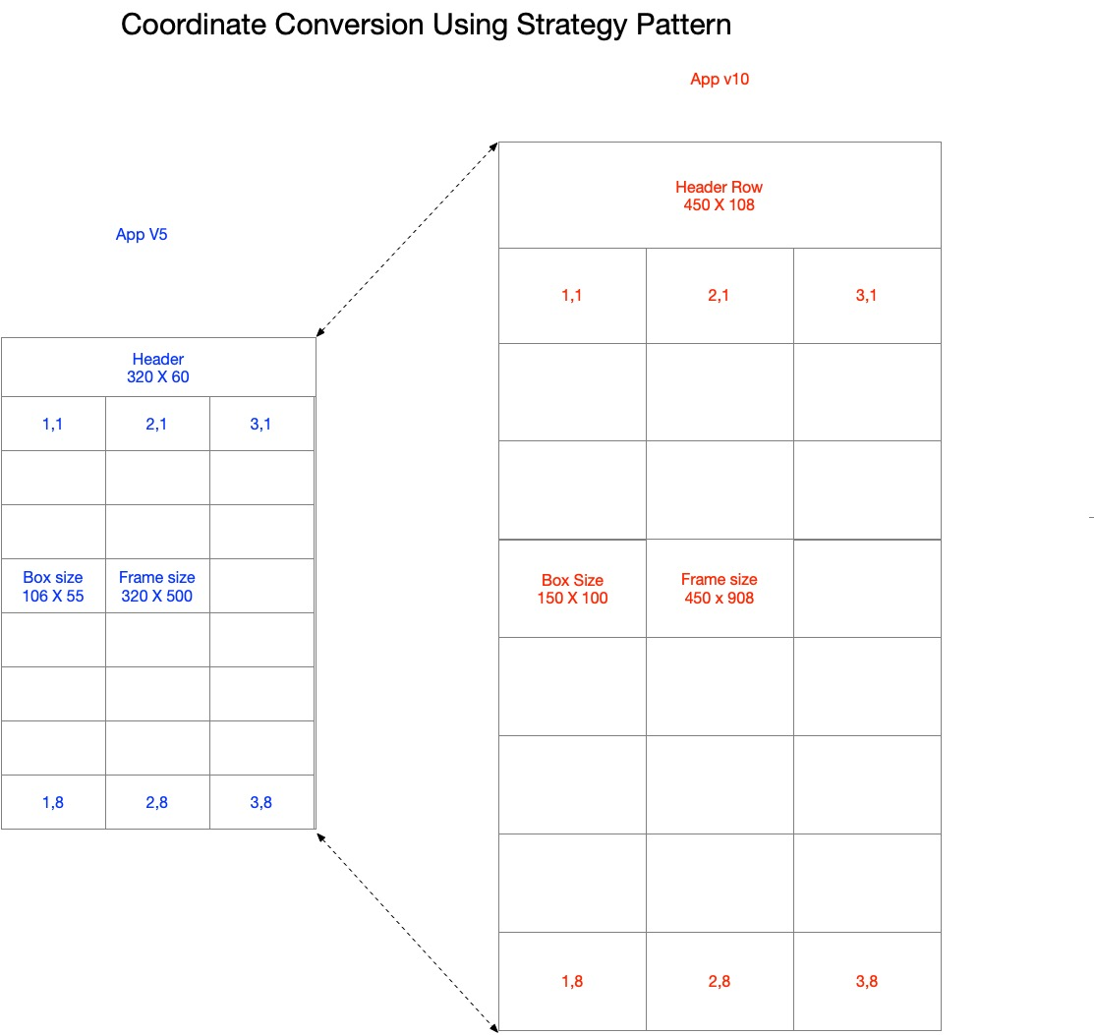
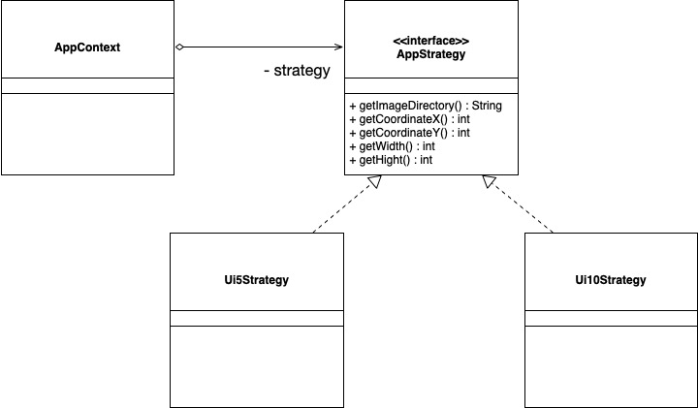
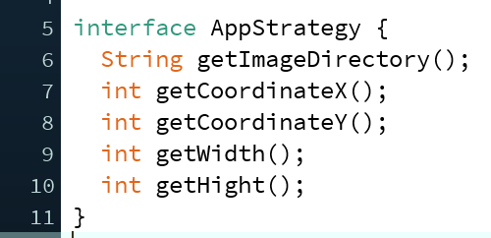
Strategy

Slide 10
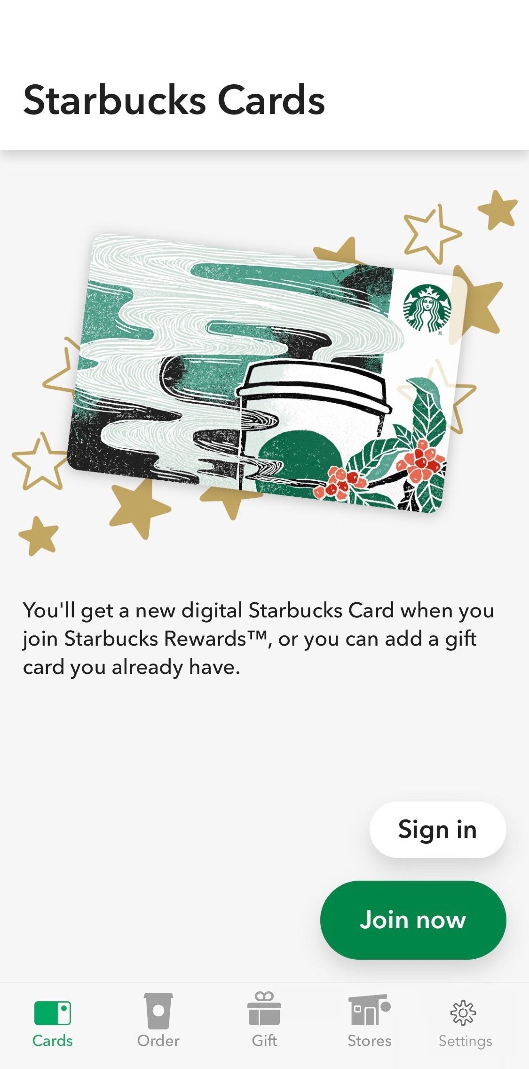
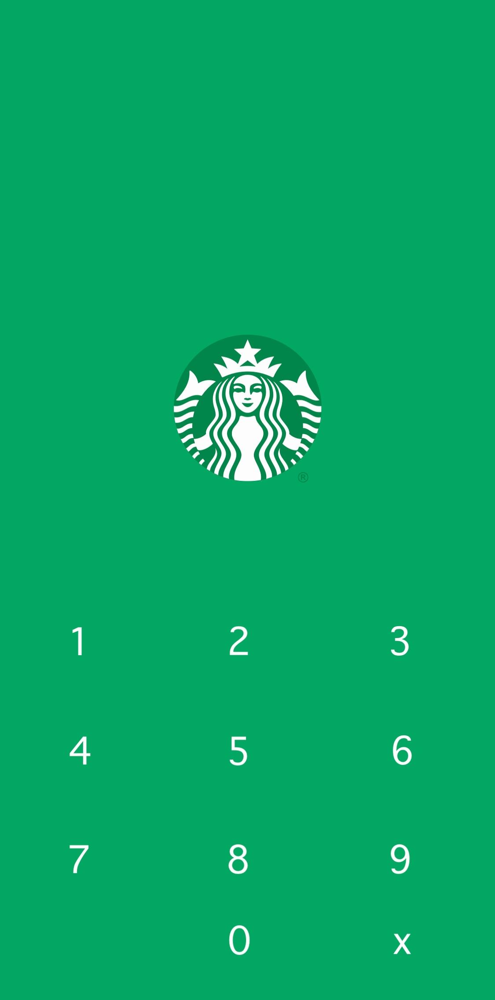
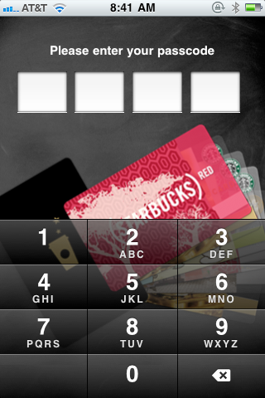
Strategy

Slide 11
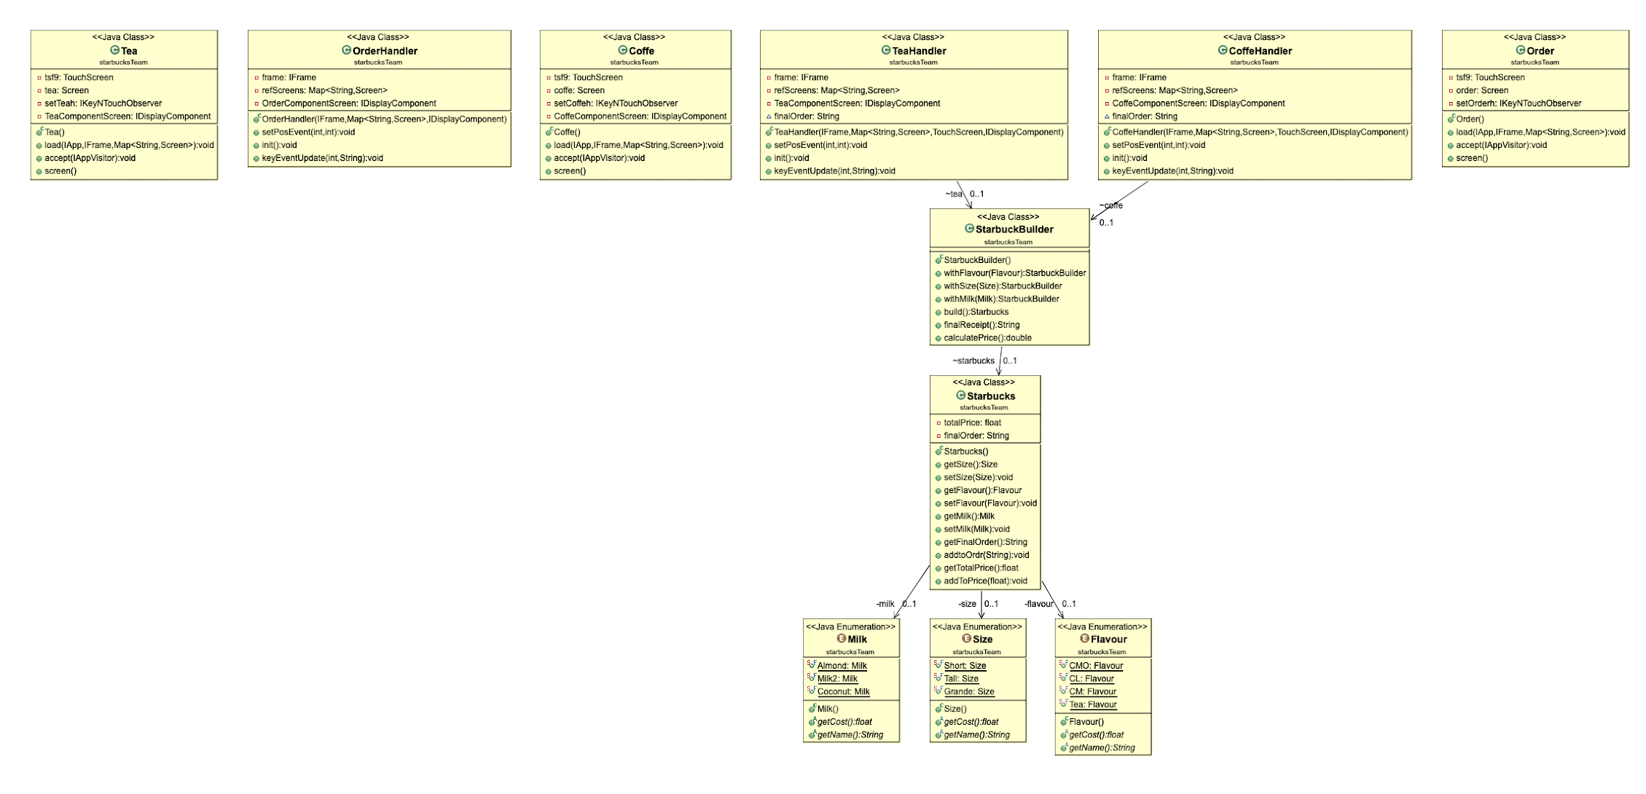
Order
Builder

Slide 12
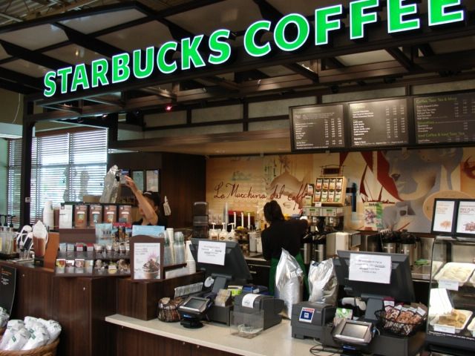
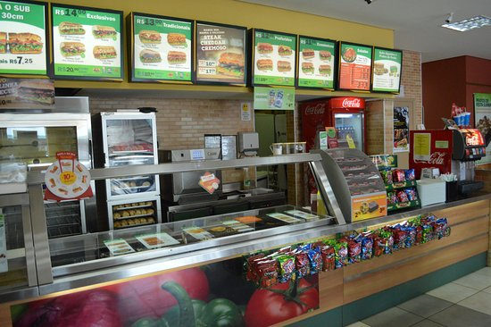
Builder
Decorator
Image Source: https://www.tripadvisor.in/LocationPhotoDirectLink-g1675614-d4445159-i241076482-Subway-Sao_Roque_State_of_Sao_Paulo.html\
https://www.tripadvisor.in/LocationPhotoDirectLink-g1675614-d4445159-i241076482-Subway-Sao_Roque_State_of_Sao_Paulo.html

Slide 13
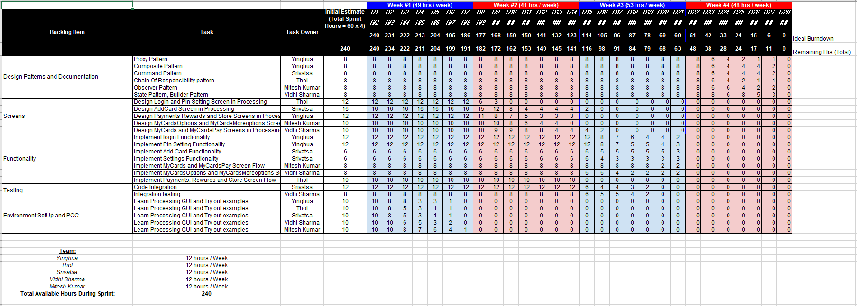

Slide 14
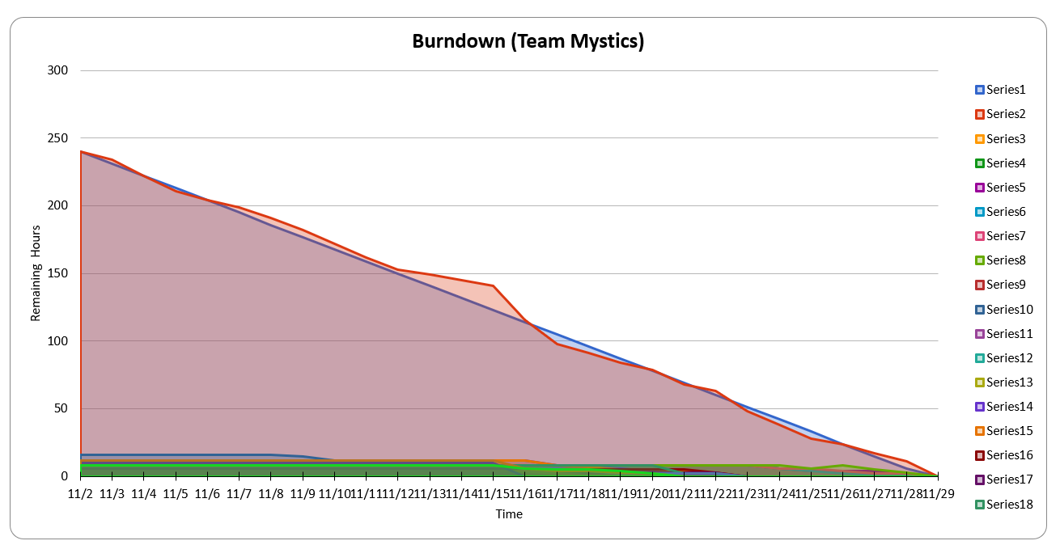

Slide 15
Future Work and Learning Summary
Easy to add more screens and features
Add shopping cart
Create processing arts
Google map integration
To support new phone models
A better design system could
reduce the engineering cost
shorten the time to market
easy to test

Slide 16
Thanks!

Slide 17
Backup Slides

Slide 18
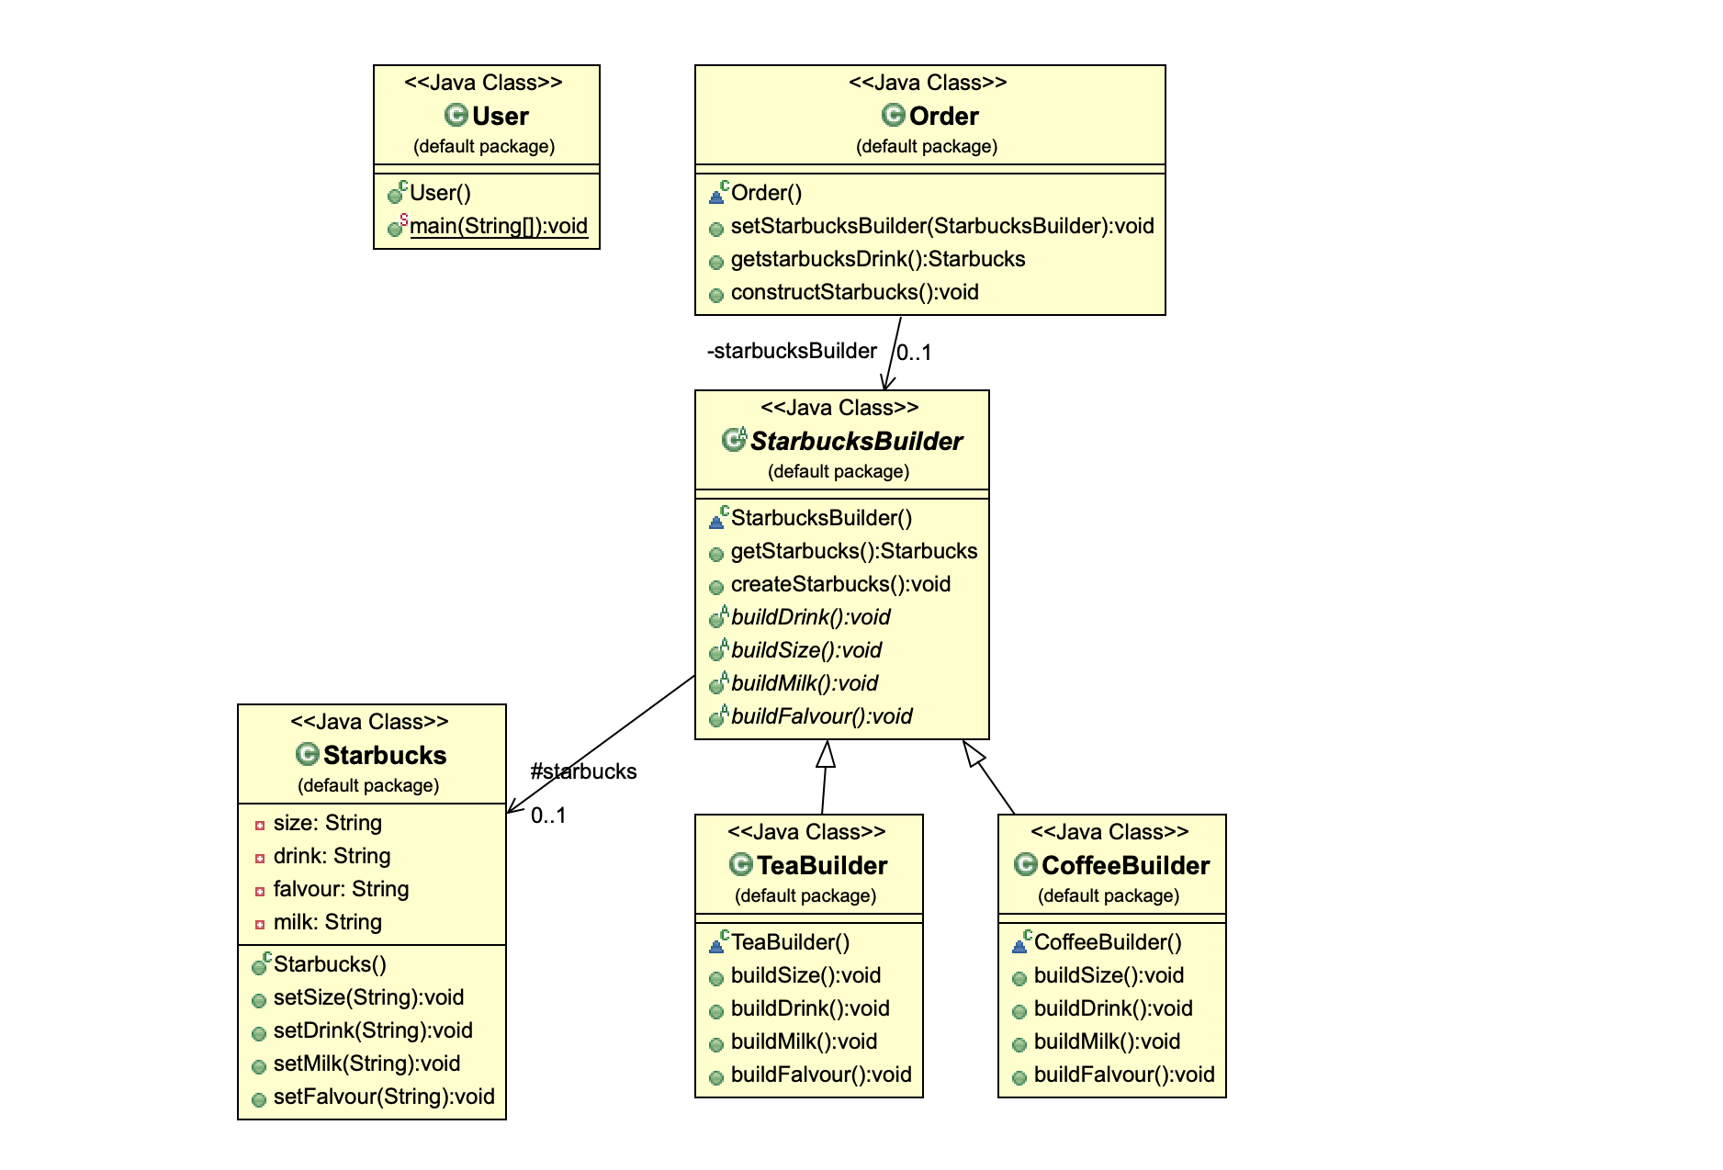
Order
Builder

Slide 19
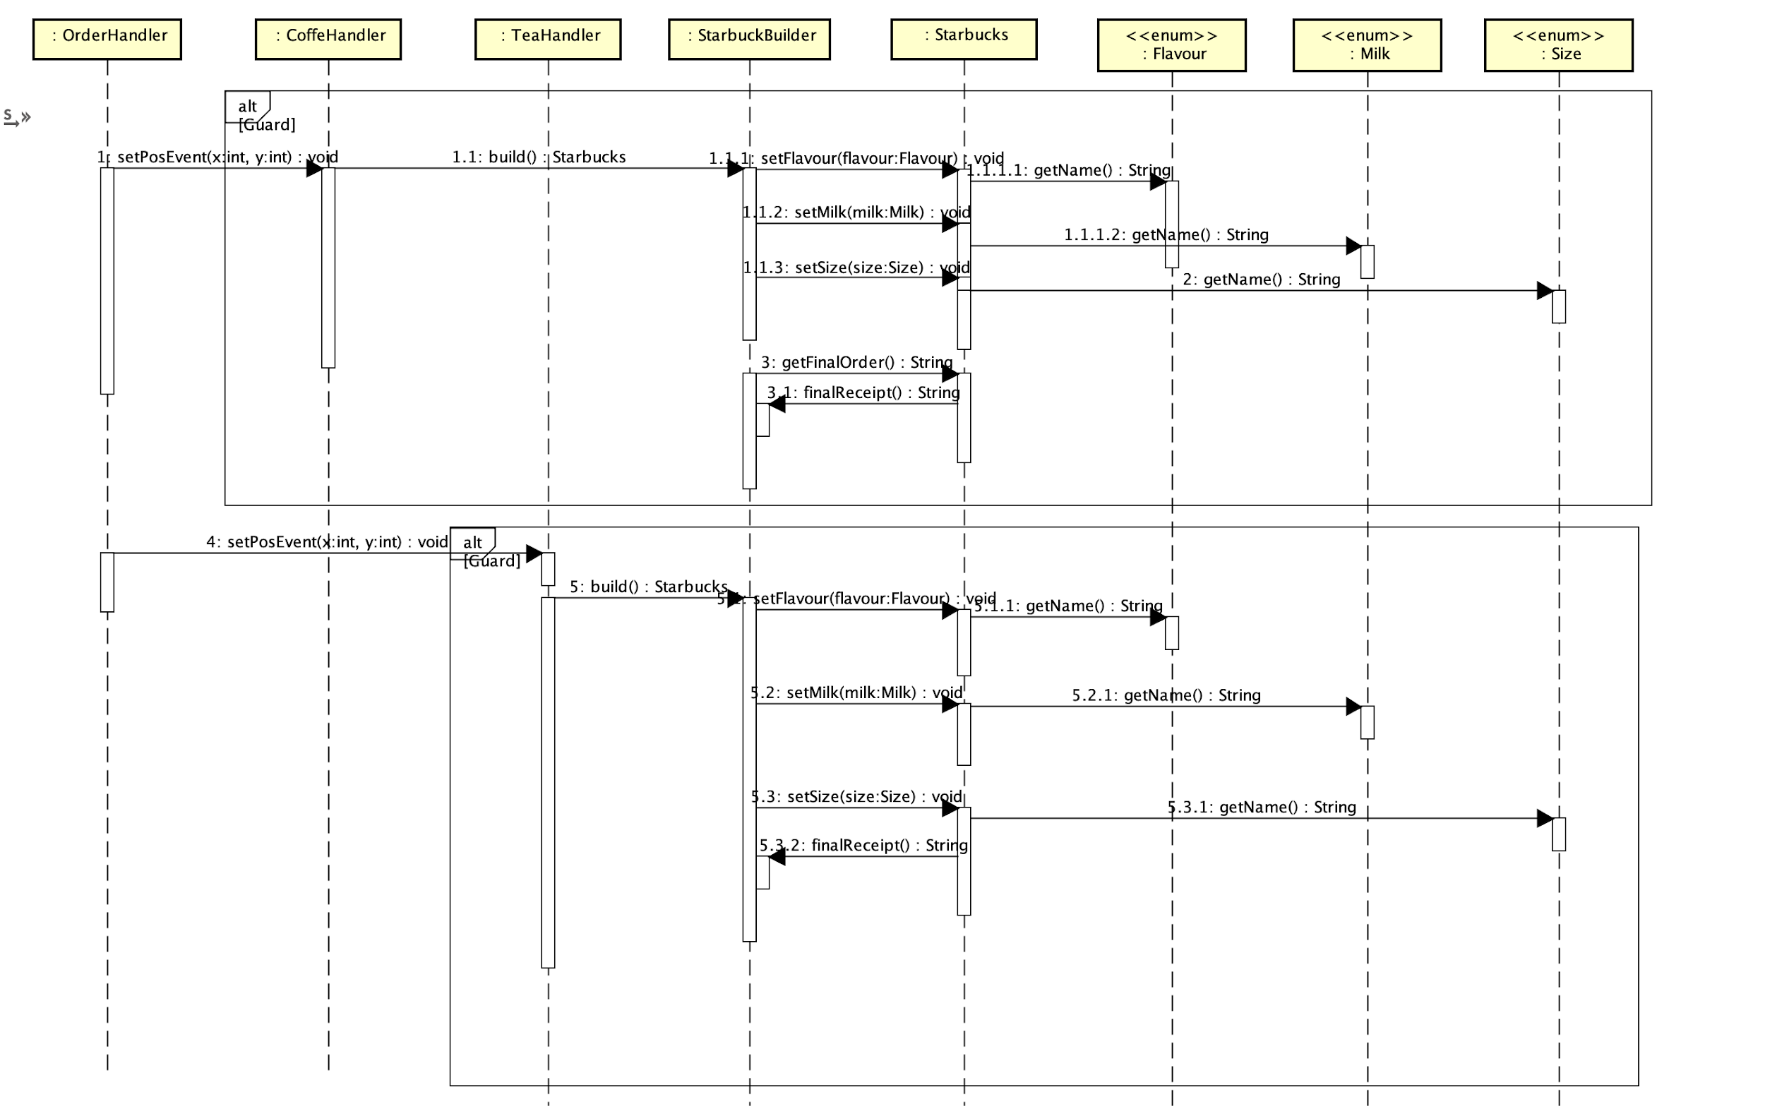
Builder

Slide 20
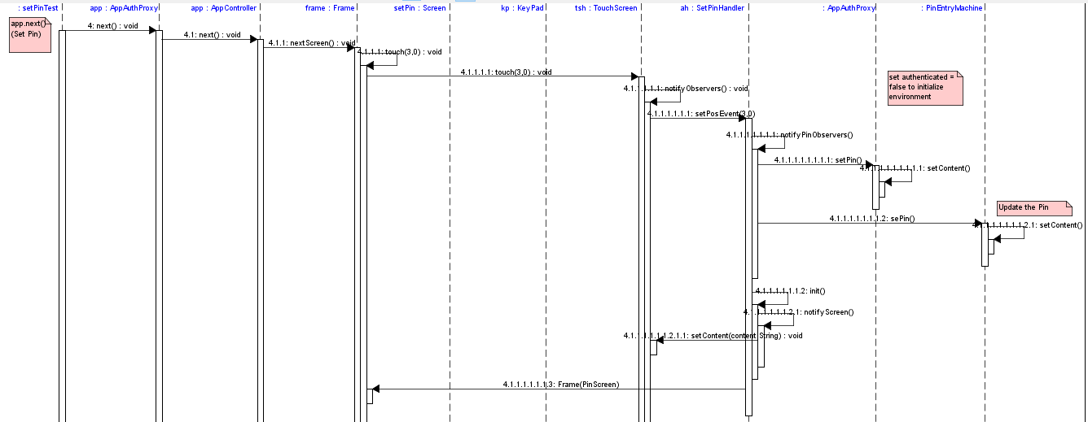
Observer

Slide 21
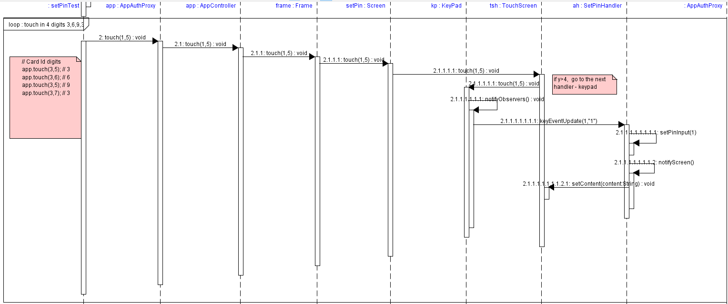
Observer

